Slide 1
PROJECT PRESENTATION
Aditya Sharma
Satya Adiya Praneeth Emani
Yangyong Zhang

Slide 2
INTRODUCTION
Downlink Transmission – Packets arrive at AP and are transmitted to various hosts.
When the packet arrives at the AP, a policy is used to forward these packets to the hardware.
Once the packet is in the hardware, we no longer have any control over the packet.

Slide 3
INTRODUCTION contd.
The hardware keeps transmitting packets until all are delivered.
The hardware will not delete a packet even when the packet expires .
Furthermore, the hardware does not distinguish the number of packets it receives at the beginning.
The hardware send a message when a packet is delivered successfully.

Slide 4
BASELINE POLICY
At the beginning of each interval, the baseline policy forwards all packets to the hardware based on the debts associated with the clients.
There is no provision for dropping of any packets before sending them to the hardware.
There is no delay in sending packets to hardware. All packets are sent to the hardware at the beginning of interval.

Slide 5
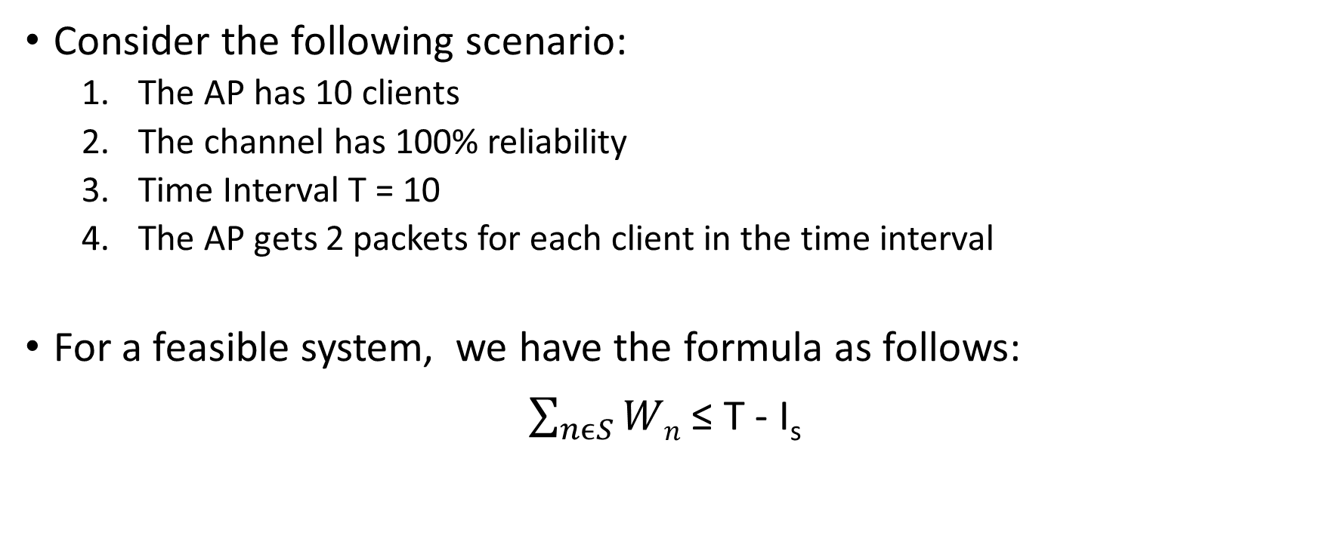
SCENARIO 1
Consider the following scenario:
The AP has 10 clients
The channel has 100% reliability
Time Interval T = 10
The AP gets 2 packets for each client in the time interval
For a feasible system, we have the formula as follows:
$\sum_{nϵS}{Wn}$ ≤ T - I_{s}

Slide 6
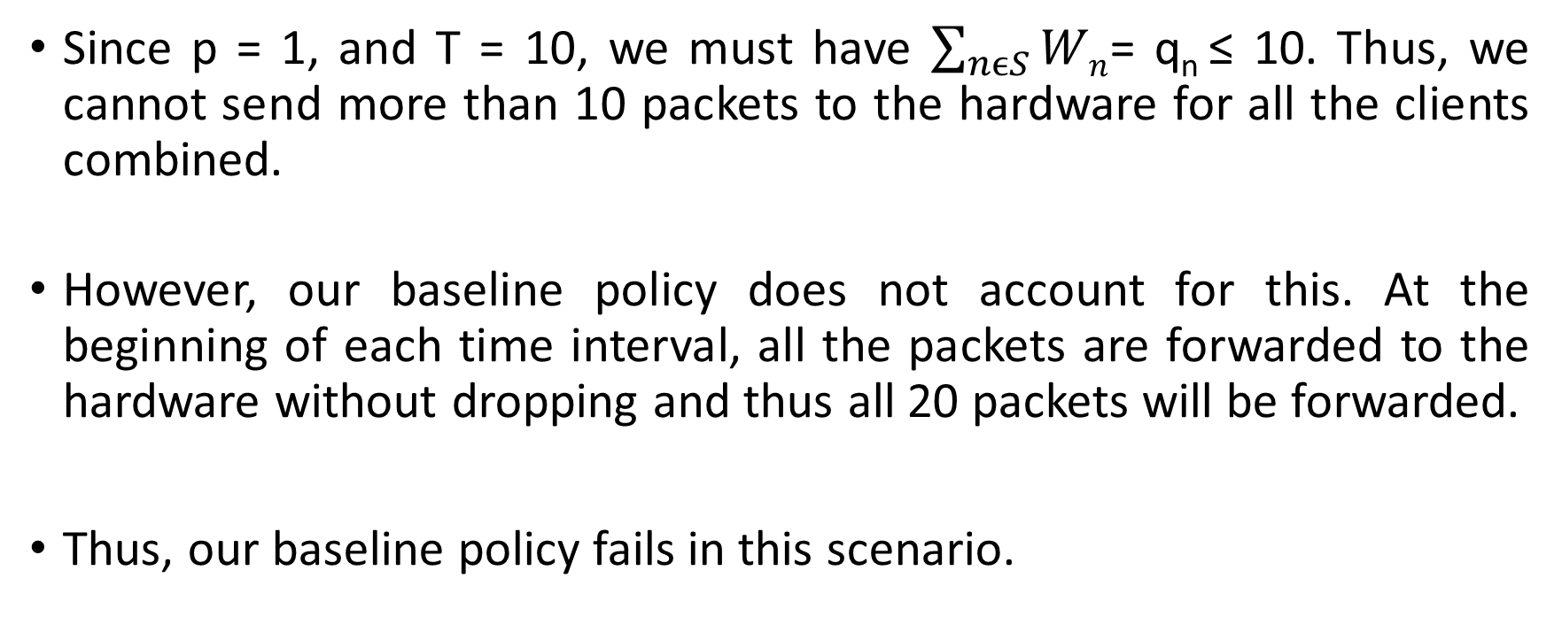
SCENARIO 1 contd.
Since p = 1, and T = 10, we must have $\sum_{nϵS}{Wn}$= q_{n} ≤ 10. Thus, we cannot send more than 10 packets to the hardware for all the clients combined.
However, our baseline policy does not account for this. At the beginning of each time interval, all the packets are forwarded to the hardware without dropping and thus all 20 packets will be forwarded.
Thus, our baseline policy fails in this scenario.

Slide 7
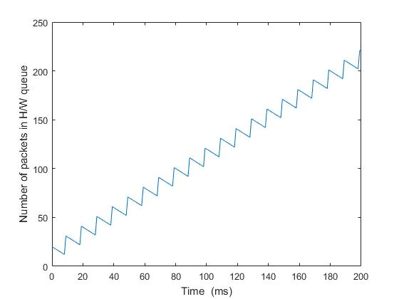
NUMBER OF PACKETS IN HARDWARE

Slide 8
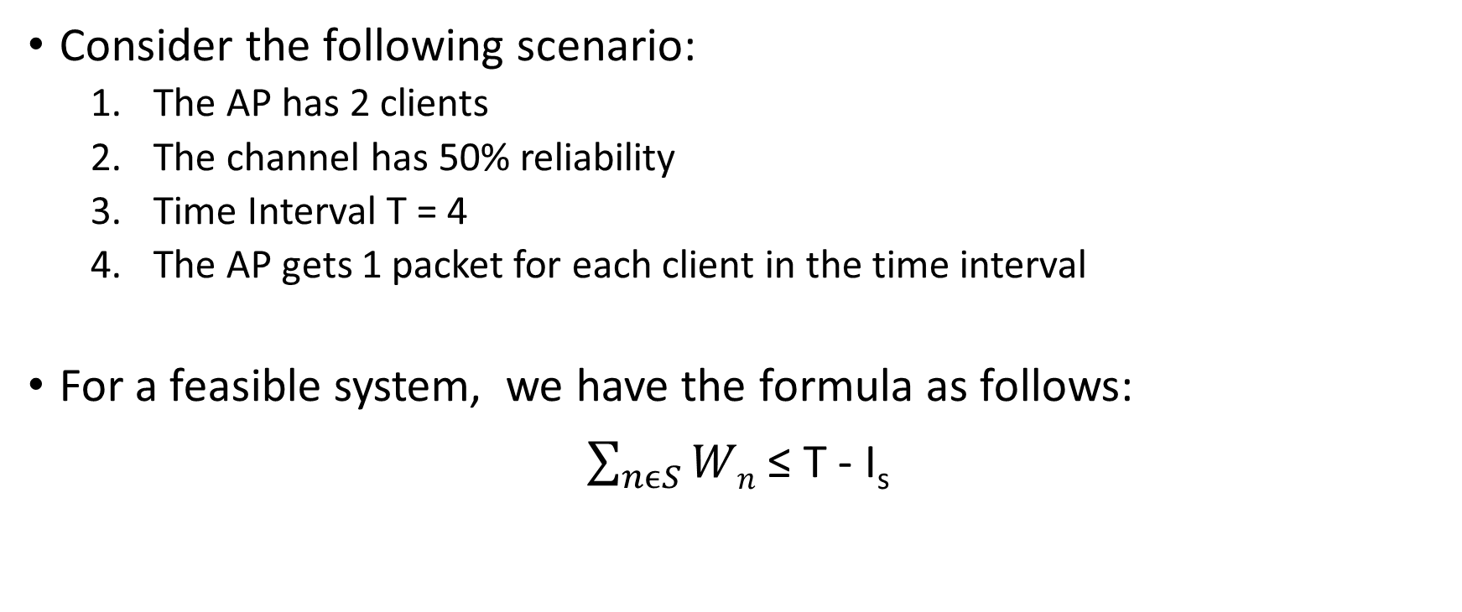
SCENARIO 2
Consider the following scenario:
The AP has 2 clients
The channel has 50% reliability
Time Interval T = 4
The AP gets 1 packet for each client in the time interval
For a feasible system, we have the formula as follows:
$\sum_{nϵS}{Wn}$ ≤ T - I_{s}

Slide 9
SCENARIO 2 contd.
Since p = 0.5,N = 2 and T = 4 we get Is and thus we must have q_{n} ≤ 0.8125. Thus, while it is possible to send 2 packets to 2 clients in our scenario, we might not be able to send this all of the time.
Our baseline policy does not allow for us to drop packets. Thus, we see that packets are carried over from the previous interval if they are not sent.
Thus, our baseline policy fails in this scenario.

Slide 10
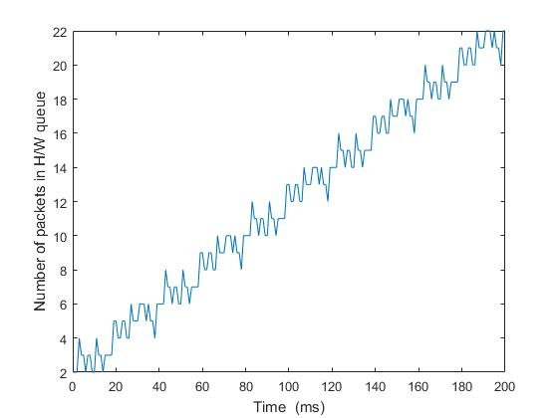
NUMBER OF PACKETS IN HARDWARE

Slide 11
SUMMARY
We have a baseline policy that forwards all packets at once at the beginning of the interval.
We see that this policy fails during different scenarios and thus must be adjusted.
The inability to delay packets and the inability to drop packets saturates the queue in the hardware thus rendering communication impossible after a while.

